Slide 1
RFS 57-22 Northwest Reclaimed Water System Master Plan
Pre-Submittal Meeting
June 16, 2022

Slide 2
Housekeeping Rules
This meeting will be recorded. I will begin the recording now.
Please put your name and contact information to document attendance for this meeting in the chat box
Please mute your mic if you are not speaking
Use the raise hand feature if you wish to speak or ask a question
You can also use the chat feature to ask a question

Slide 3
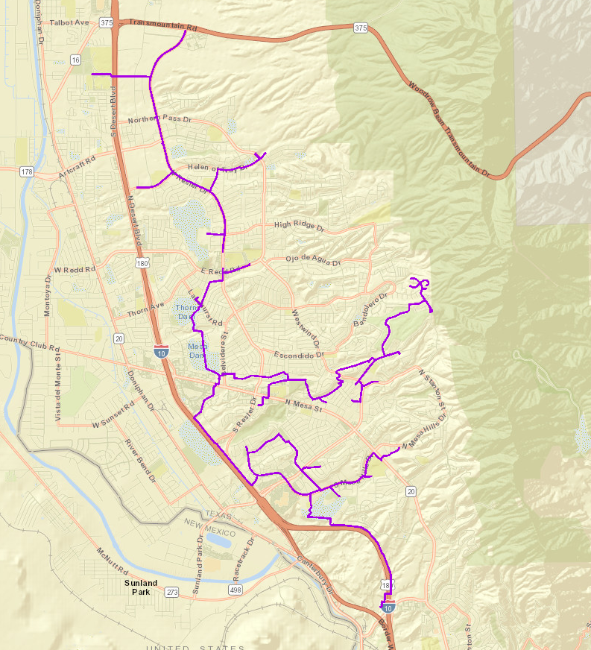
Northwest Reclaimed Water System Master Plan
Background Information
EPWater has been delivering reclaimed water to the community since 1963. The northwest reclaimed water system is used to supply irrigation water to the EPWater customers on the west side of the city. The reclaimed water is used to irrigate golf courses, city parks, school grounds, apartment landscapes, construction, and industrial sites. EPWater has recently completed the coating and structural inspection for the steel reclaimed water ground storage tanks at Coronado Country Club I and III, Fred Miller, and Mesa Hills.

Slide 4
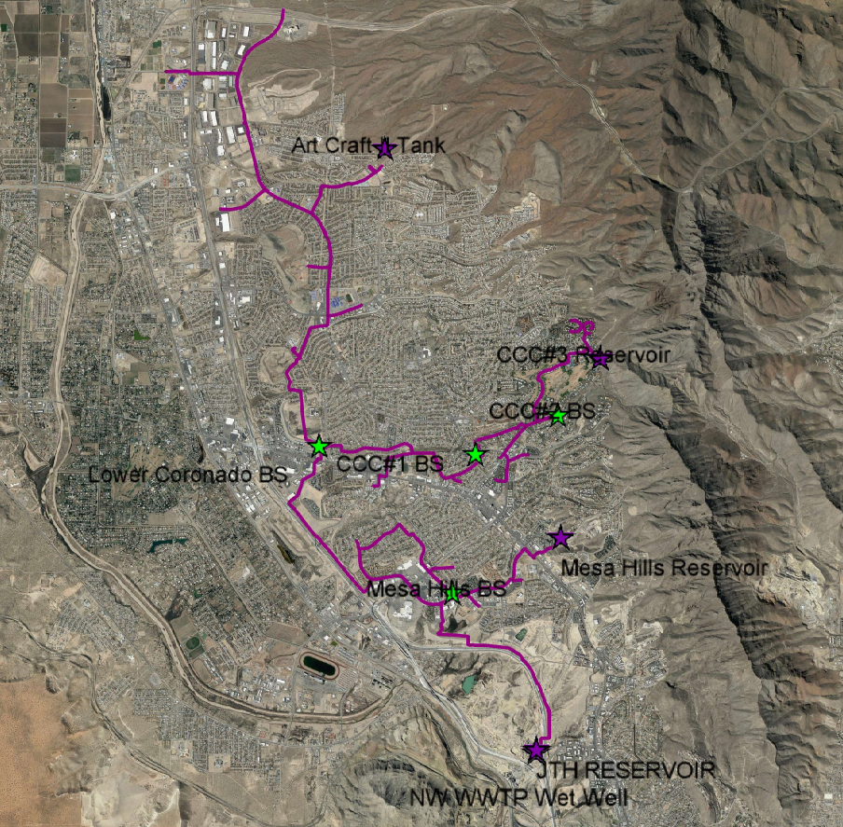
Northwest Reclaimed Water System Master Plan
Northwest Reclaimed System General Map
Reservoir
Pump Station
Pipeline

Slide 5
Northwest Reclaimed Water System Master Plan
Tentative Scope of work
Perform demand analysis,
Condition assessment of tanks, valves, appurtenances
Condition assessment of above & below-grade piping
Condition assessment of electrical components
Recommendations and plan to isolate tanks and pipelines
Risk analysis & Cathodic protection plan
Development of Capital Improvement Plan

Slide 6
Northwest Reclaimed Water System Master Plan
Tentative Scope of Services
Review available engineering reports, As-builts and provided hydraulic data
Several Technical Memorandums will be required
Project coordination and permitting
Consideration of flexibility to future development and or impact on commercial development
Coordination with EPWater Engineering, Operations, Maintenance staff, City and County entities, El Paso Independent School District, private owners, and others if necessary
Field Data gathering;
Prepare engineering opinion of probable construction costs

Slide 7
Northwest Reclaimed Water System Master Plan RFS Schedule Dates
EPWater issues RFQ………………………………………….............June 7, 2022
Non-Mandatory Pre-Submittal Meeting ………………………………June 16, 2022, at 3:00 P.M. (MST)
Deadline for Submission of Requests for Clarification…………......June 21, 2022, by 5:00 P.M. (MST)
EPWater provides Responses/Clarifications………………………...June 23, 2022
Deadline for Submission of SOQ and PRF………………… ……….July 8, 2022, by 3:00 P.M. (MST)
Notify Selected Team Estimated Date………………………………...August 10, 2022
Present to Board for Approval………………………………………….September 14, 2022

Slide 8
Northwest Reclaimed Water System Master Plan
Evaluation Process
Minimum Qualifications Pass/Fail
Project Approach 40 pts
Proposed Project Team & Team Experience 35 pts
Four (4) Past Project Experience 20 pts
Firm Availability 5 pts
100 pts

Slide 9
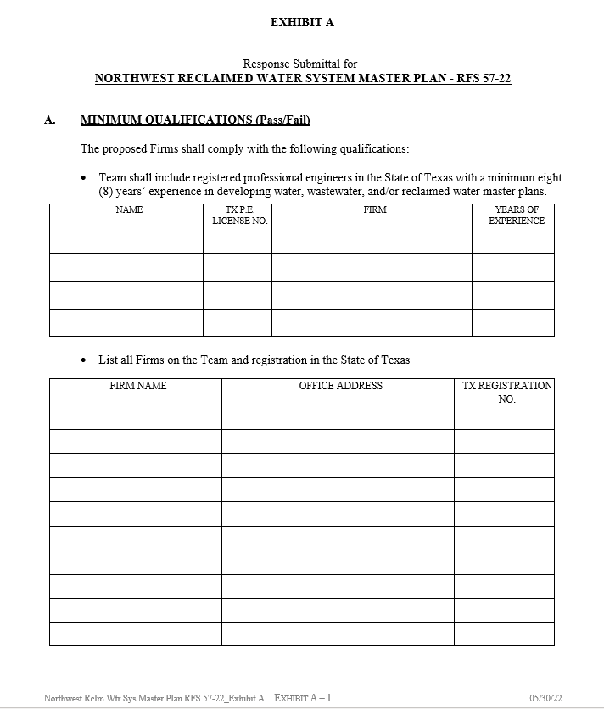
Northwest Reclaimed Water System Master Plan
Minimum Qualifications (pass/fail)
Firm shall contain registered PE’s in the State of Texas with eight (8) years minimum experience in developing water, wastewater, reclaimed, master plans
Firms must be registered in the State of Texas including subcontractors
Use Exhibit A Part A to provide this information

Slide 10
Northwest Reclaimed Water System Master Plan
Project Approach (40 pts):
Provide a brief discussion on proposed technical solutions to the condition, hydraulics, risk, and cost to the project. Provide suggestions of various alternatives. A firm will be evaluated on its ability to address the project issues and objectives.

Slide 11
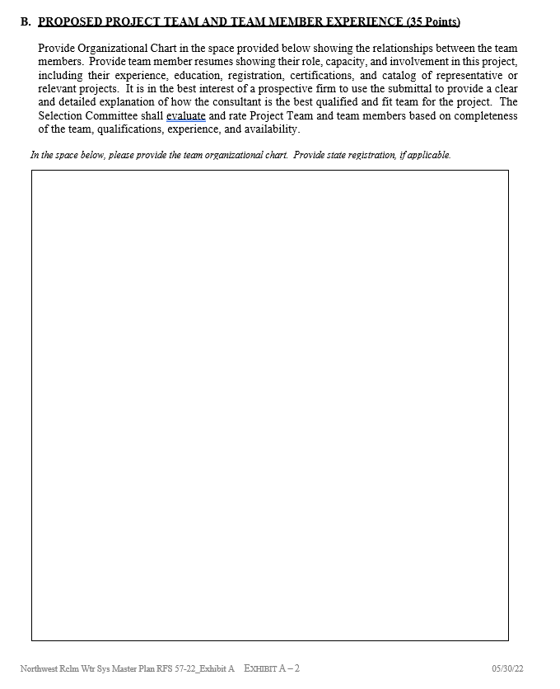
Northwest Reclaimed Water System Master Plan
Proposed Project Team And Team Member Experience (35 Points)
Team Organization Chart
Relationship between members and firms
EPWater shall be included on the organization chart
Use Exhibit A Item B

Slide 12
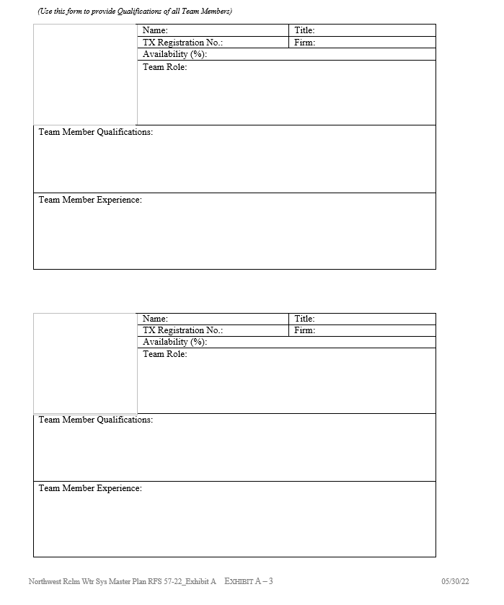
Northwest Reclaimed Water System Master Plan
Team Member Experience
Resume/ education, registration, certification
Role
Availability to the project Qualification and Experience
Firm Profile of sub-consultants

Slide 13
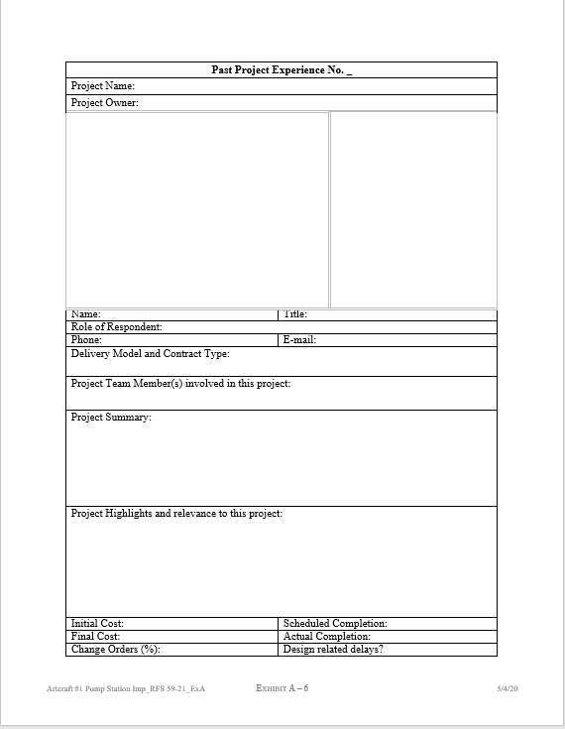
Northwest Reclaimed Water System Master Plan
Past Project Experience (20 Points)
Four (4) projects required (past ten years)
Project descriptions: name, owner, location, cost, completion, team members involved, their role
Each project experience can scope up to 5 points each

Slide 14
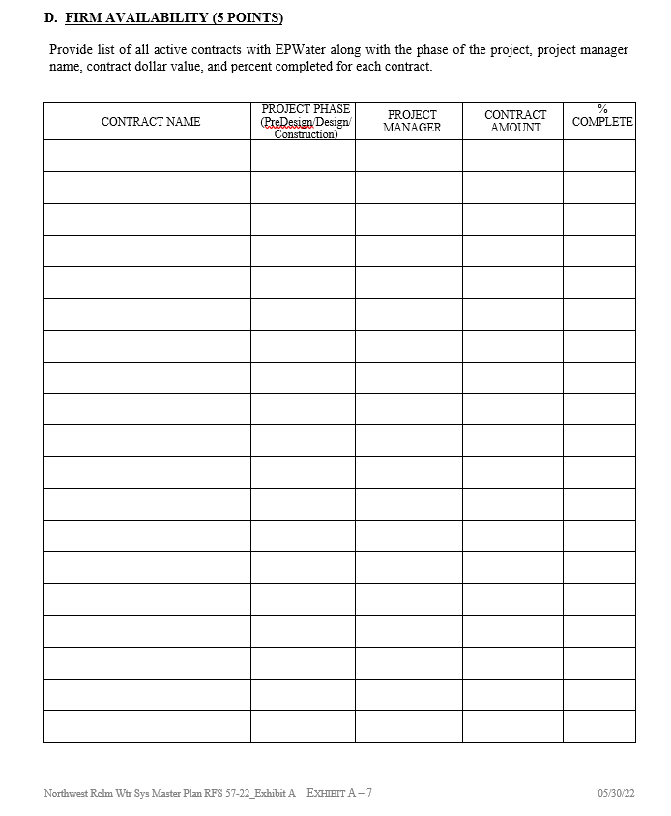
Northwest Reclaimed Water System Master Plan
Firm Availability (5 Points)
Provide list of all contracts with EP Water
Project Phase
Firm Project Manager Name
Contract Value
Percent Completed
For On-Call contracts, list only active task orders

Slide 15
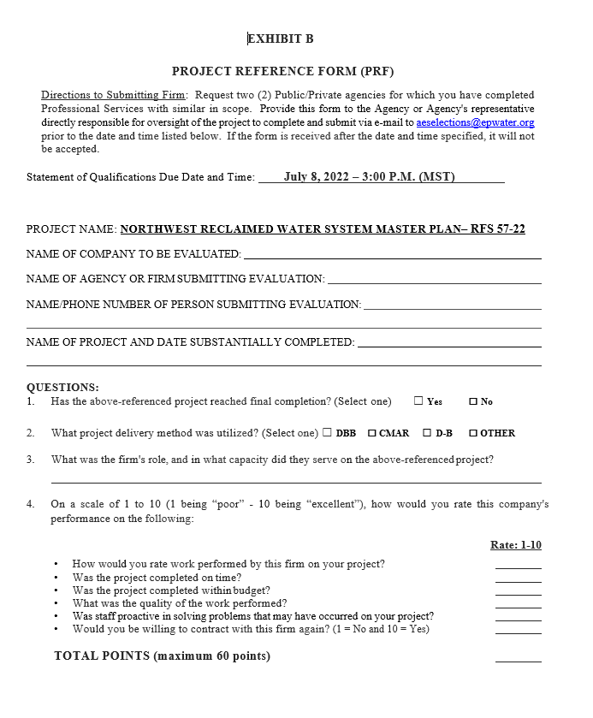
Northwest Reclaimed Water System Master Plan
Project References Form
List the name of the two public or private agencies
PRF must be submitted directly by the agency providing the references
Email to: aeselections@epwater.org

Slide 16
Required Information and Format
Request For Submittals Shall Be Limited To The Listed Information Below:
Cover Page (One Page)
Cover Letter (One Page)
Project Approach (five pages)
Minimum Qualification and Technical Competence (Use Exhibit A, Part A)
Proposed Team And Team Member Experience (Use Exhibit A, Part B)
Past Project Experience (Use Exhibit A, Part C)
Firm Availability (Use Exhibit A, Part D)
List of Agencies & Project Reference Form (Use Exhibit A Part E & Exhibit B)
SOQ Shall Be Submitted Via Email To aeselections@epwater.org.
PDF File Size Shall Be No More Than 10 Megabytes. Download links are not acceptable for submittal.

Slide 17
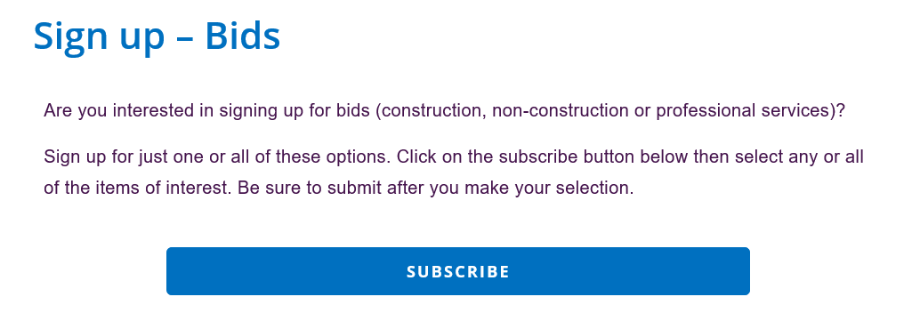
To receive newsletters notification for this RFS, subscribe at EPWater Website:
https://www.epwater.org/business_center/purchasing_overview/bids/sign_up___bids

Slide 18
QUESTIONS?
aeselections@epwater.org

